Slide 1
Topological analysis of the Human Prefrontal cortex
CSIC5011 Final project
LEE Jooran, WANG Minghao

Slide 2
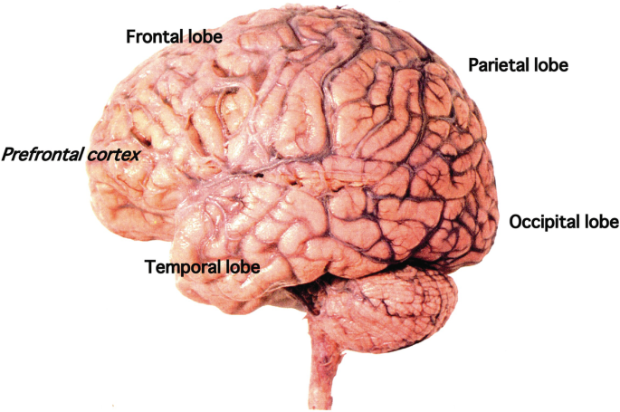
Mammalian prefrontal cortex
A highly specialized brain areas containing billions of cells and serves the centre of the highest-order cognitive functions.
Dysfunction of the prefrontal cortex contributes to cognitive deficits, however, it is still difficult to identify cell types in the developing human prefrontal cortext and to distinguish their features.

Slide 3
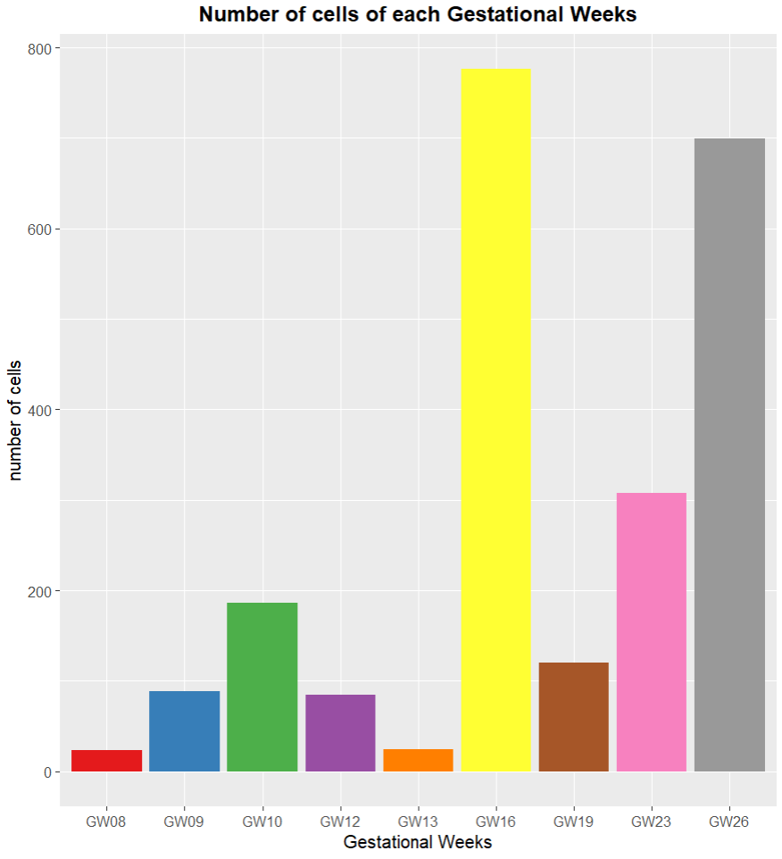
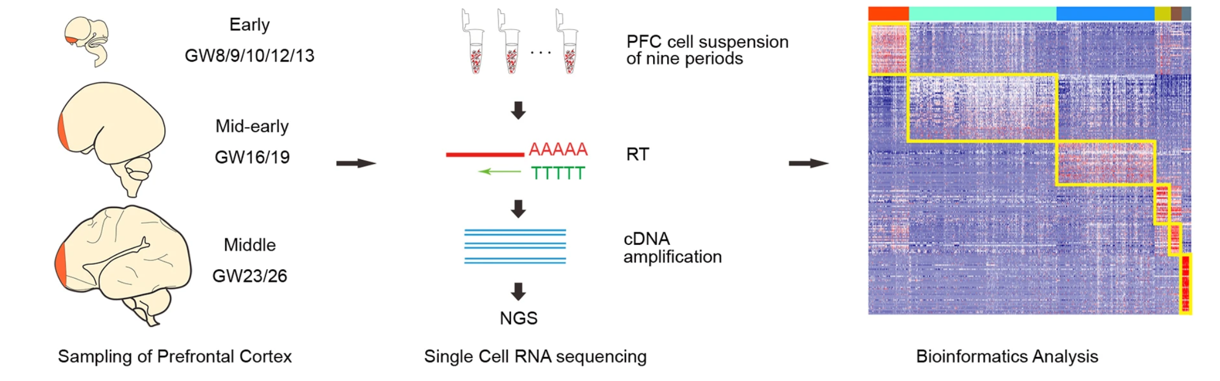
Dataset and software
2,309 single-cells in the developing human prefrontal cortex from gestational weeks (GW) 8 to 26 using RNA sequencing.
TPM (Transcripts per million) count matrix of the 24,153 matrix was used as a gene expression dataset.
Software: R, Python

Slide 4
Research questions
Which type of plot is the optimal for the data projection of the human PFCs?
What is the major cell types in the developing PFCs?
Differences in trajectory analysis results from several different approaches?
What are the key genes in regulating the prefrontal cortex in the developmental trajectories?

Slide 5
Topological data analysis: Original data and Foundation Model embeddings
What is foundation model?
A foundation model is a type of large-scale machine learning model that is pretrained on extensive amounts of data. These models have the ability to adapt to a wide variety of tasks without needing to be retrained from scratch.
What is foundation model embedding?
Foundation model embeddings are the dense numerical representations that these models generate from input data. An embedding is a vector that represents a word, sentence, or document in a way that captures its semantic properties. These embeddings allow the model to understand and process the input data effectively.

Slide 6
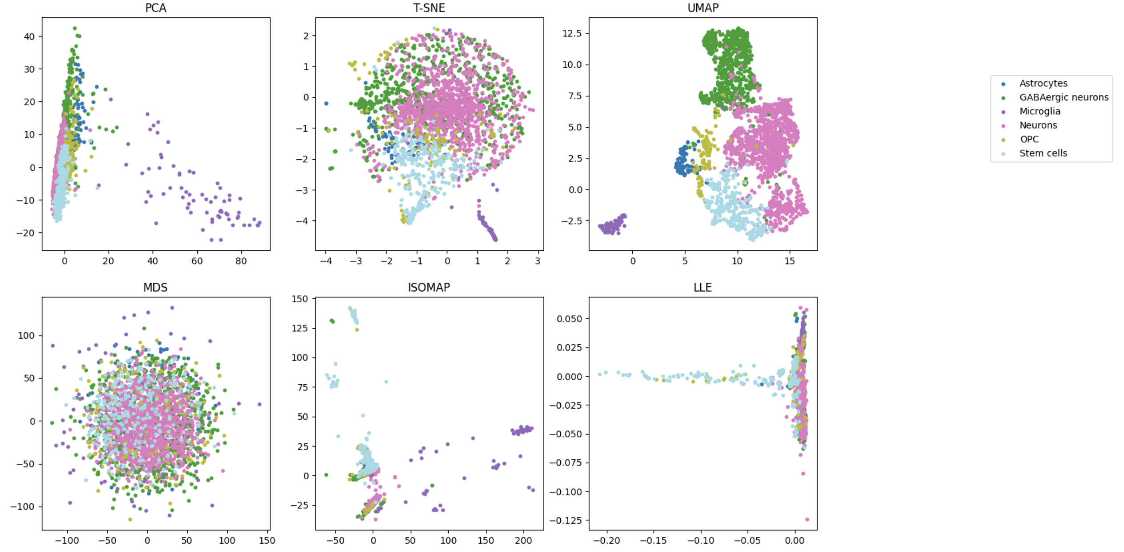
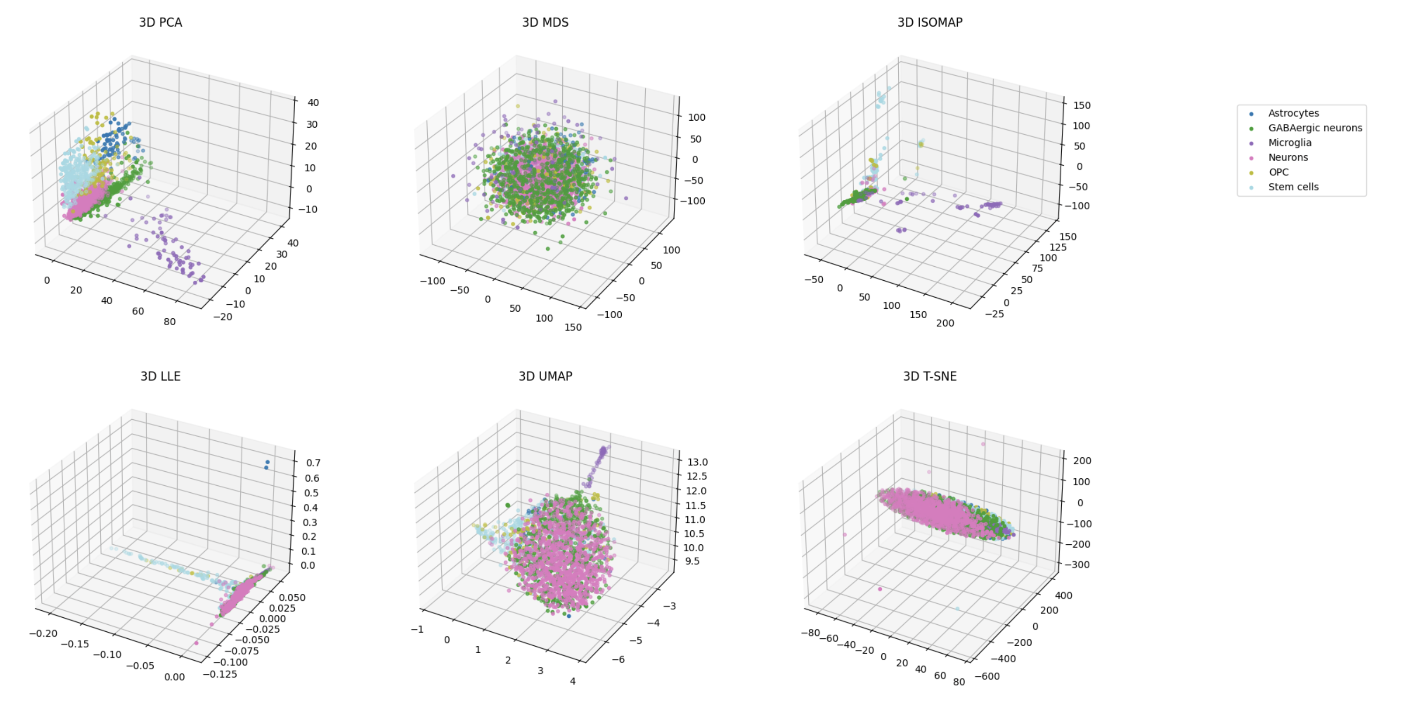
Different topology methods on original data
Only UMAP is the best without any parameter tuning.

Slide 7
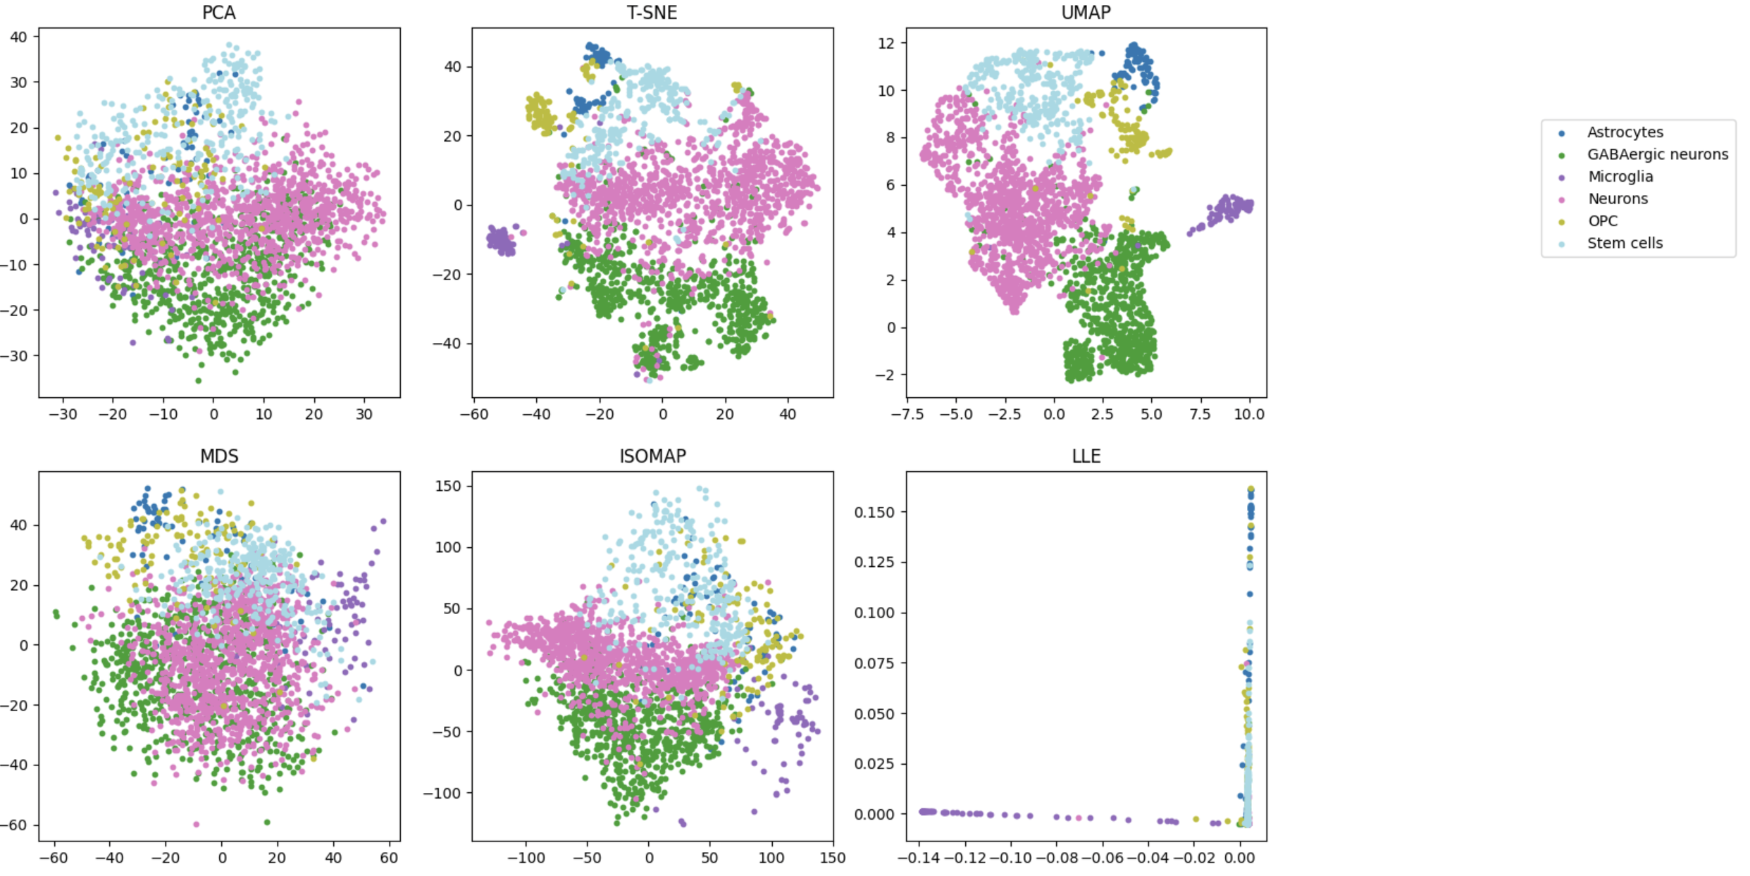
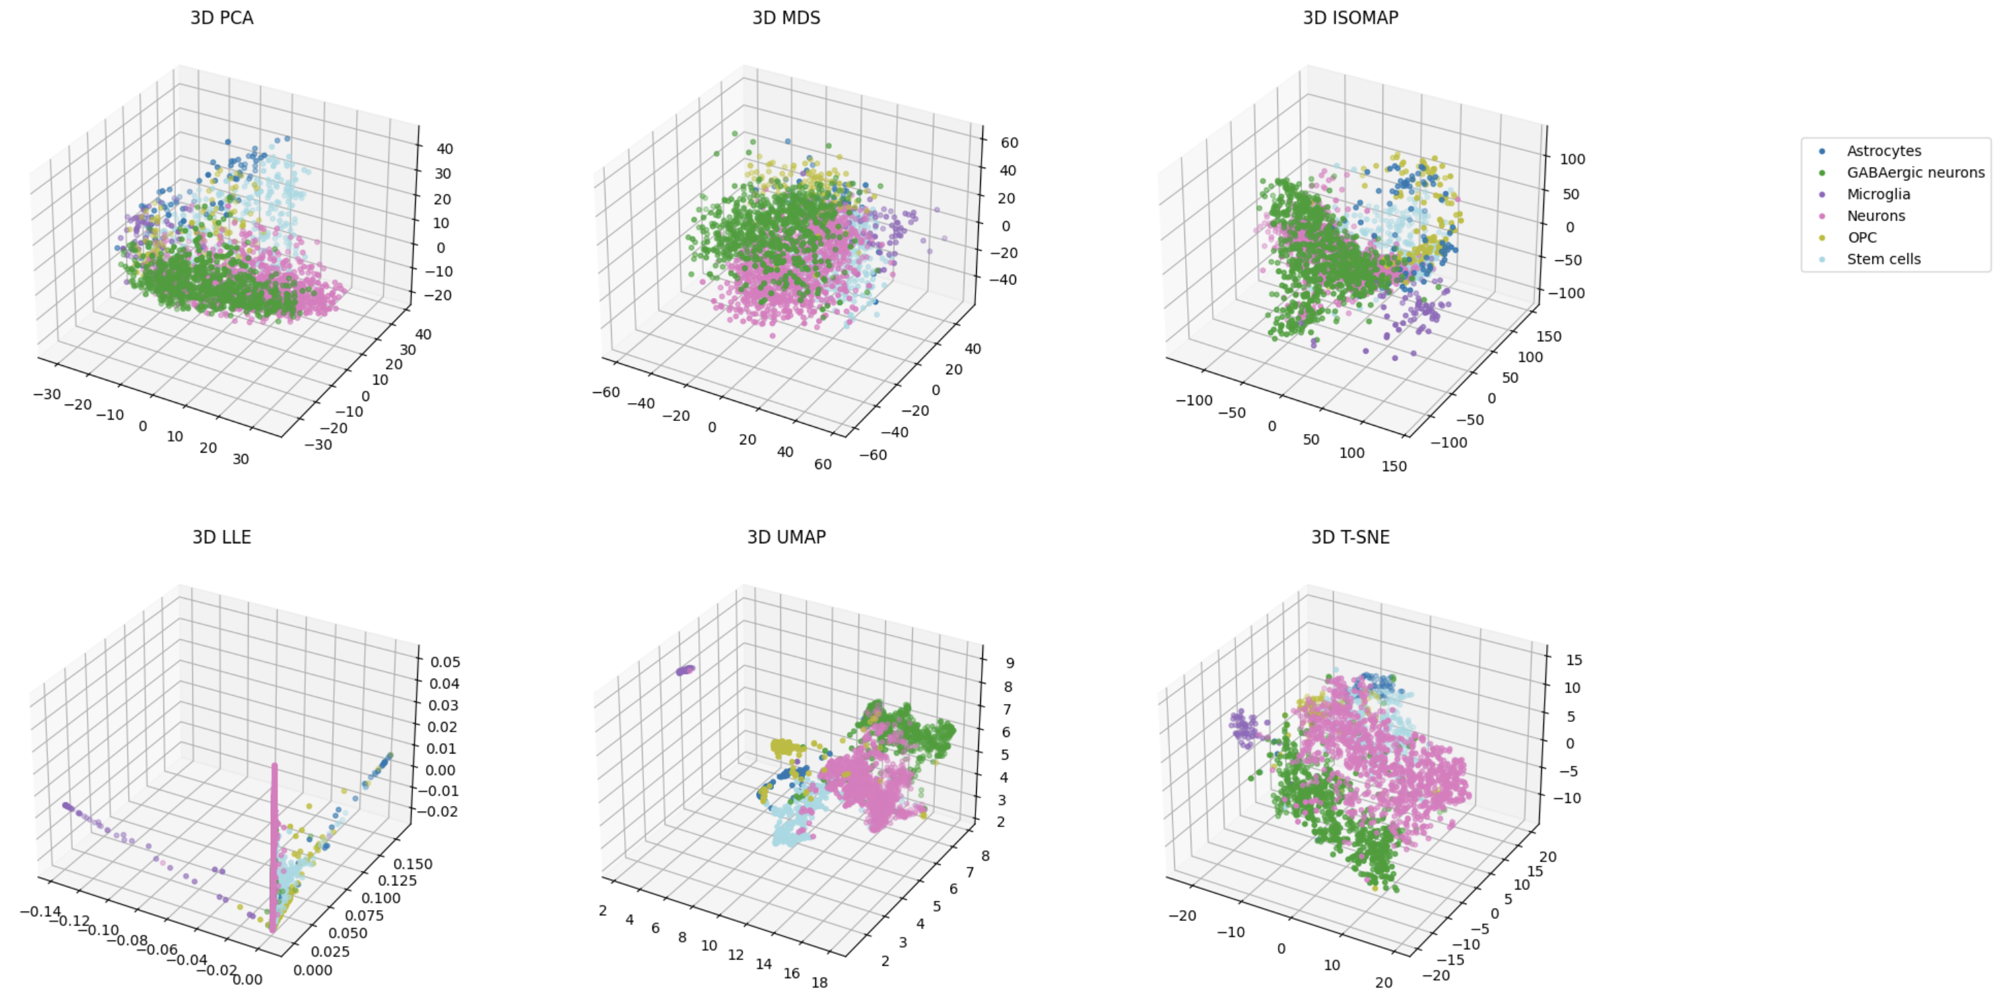
Different topology methods on Foundation model embedding
1. Foundation model embeddings can automatically project the data into a unified space such that no permutation are required on topological analysis.
2. T-SNE and UMAP are the most suitable methods for biological data analysis.

Slide 8
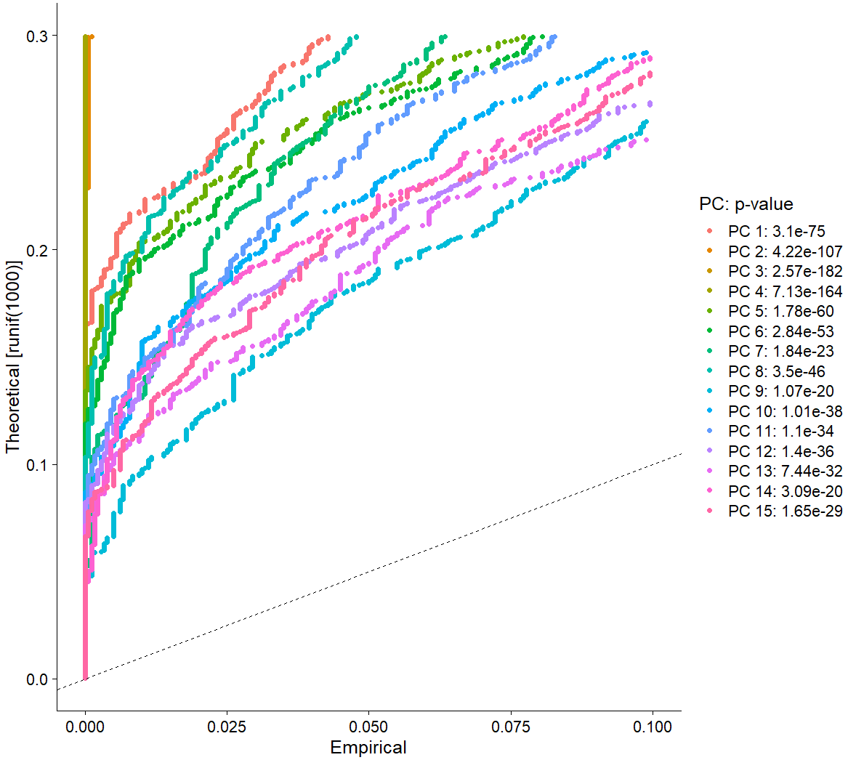
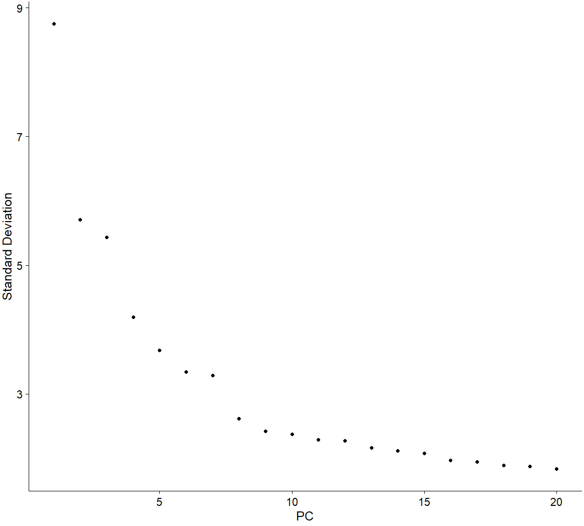
Dimensional reduction
The number of dimensions were identified by using the JackStraw and ElbowPlot. (dims = 1:15 is chosen)

Slide 9
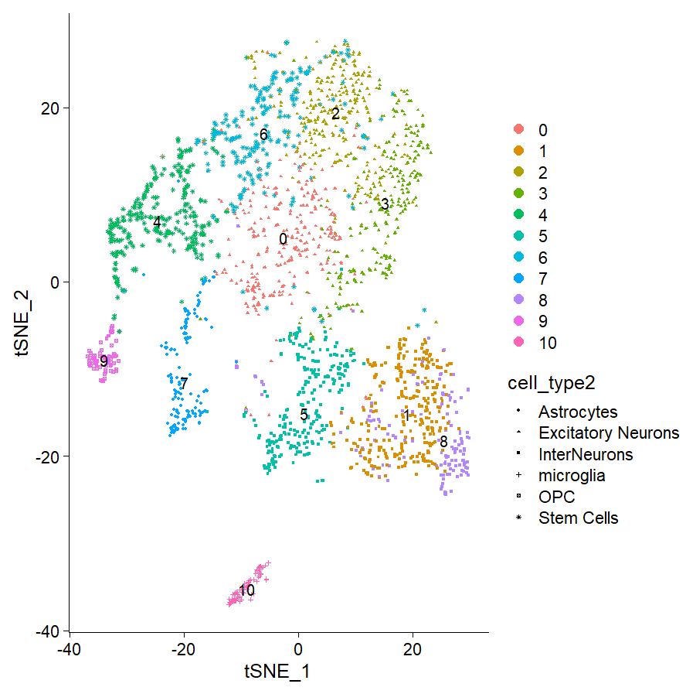
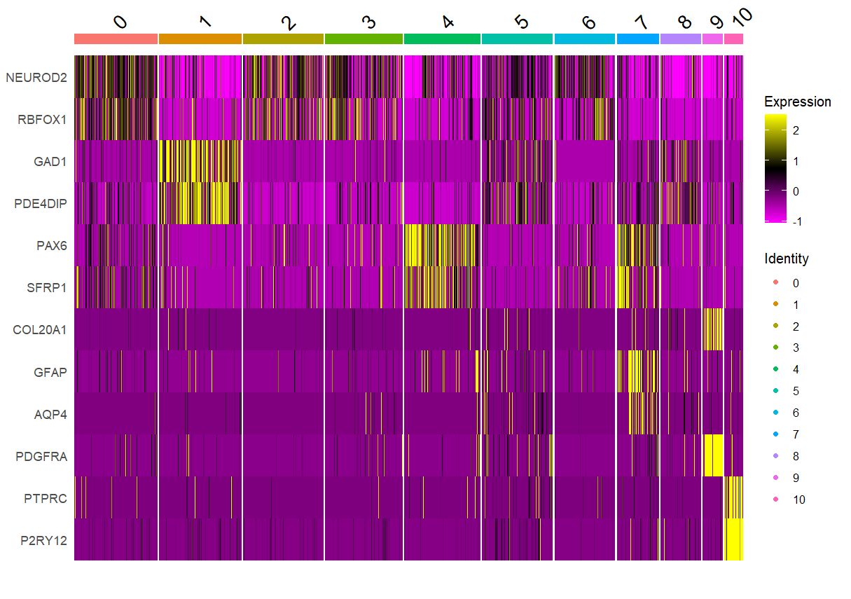
Identification of the cellular subgroups
To classify the major cell types in the developing PFC, the t-distributed stochastic neighbour embedding (T-SNE) analysis using Seurat was done and identified 11 major clusters.
The T-SNE plot was plotted after dimensional reduction, where the cell-types were manually labelled based on the marker gene expressions.
Excitatory neurons
Interneurons
NPCs
OPCs
Astrocyte
Microglia
Notes:
And by using the human cortex data given, we tried to label the cells. So, we firstly performed the dimensional reduction, and after that, we tried to cluster the cells into several groups, resulting in the 11 clusters as can be seen in the tSNE plot. And the cell-type of each cluster is labelled based on their marker gene expression on the heatmap on the right.
For instance, the cell-type called “microglia” is known to highly express two genes, called PTPRC, and P2RY12, and among all 11 clusters, cluster 10 was the only one that is highly expressing this marker genes, therefore, the cluster 10 was marked as microglia, and the similar logic was applied to other clusters, and their cell-type were labelled in a similar way.

Slide 10
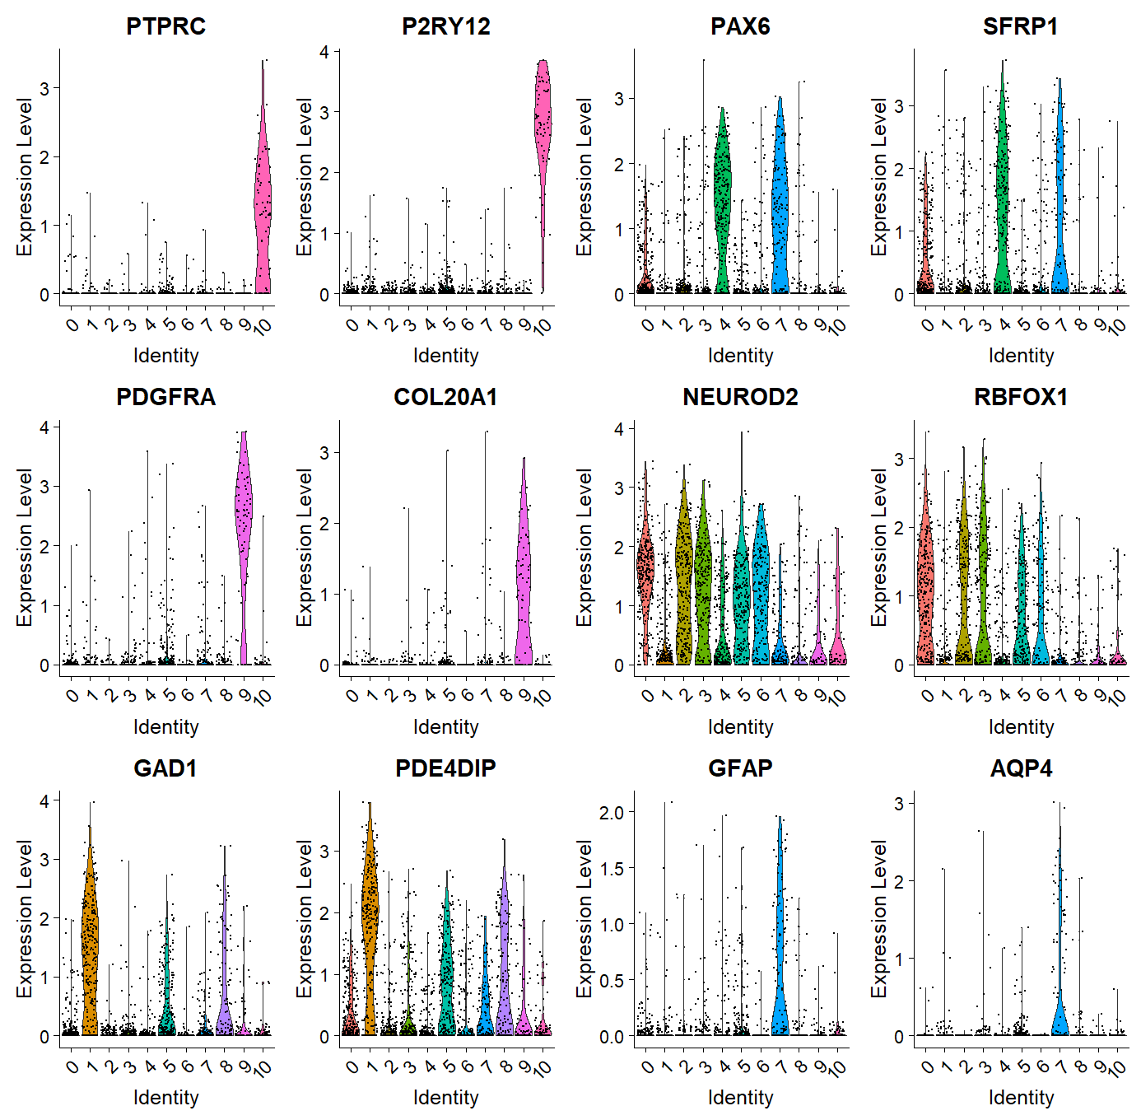
Violin plot of the canonical marker genes of the cell types enriched in the PFC

Slide 11
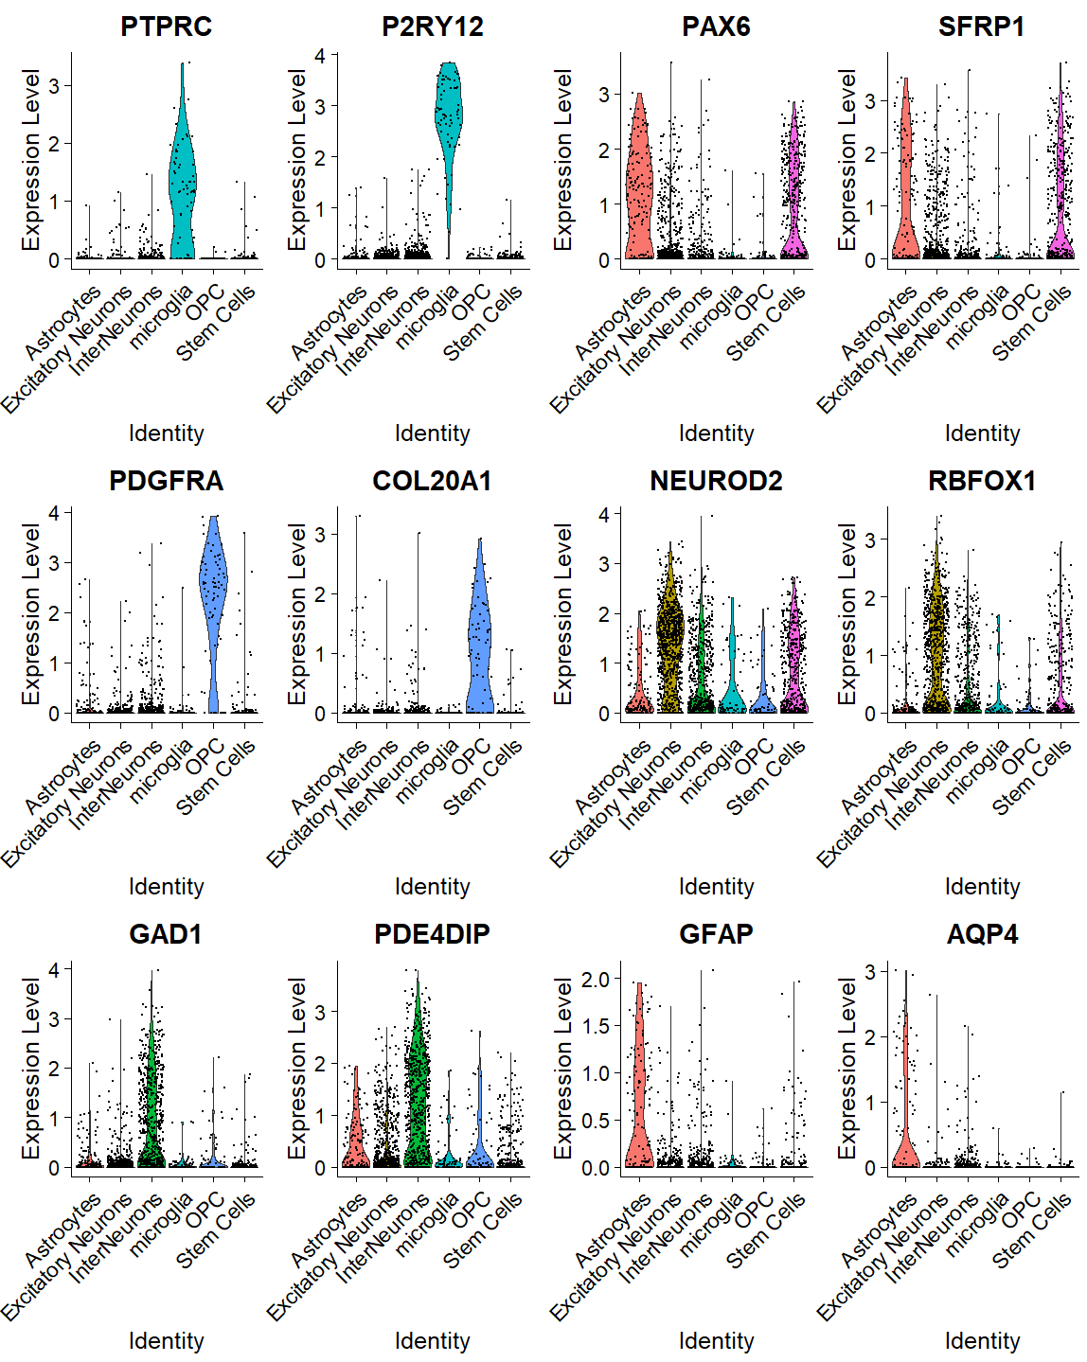
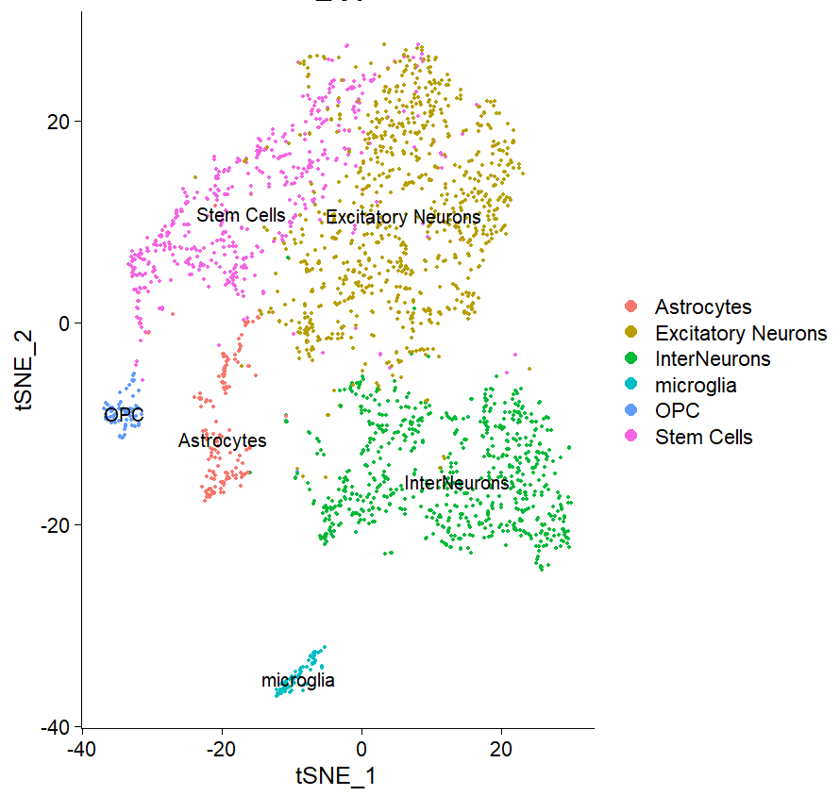
Cell-type labelling of the subgroups
Microglia
NPCs
The T-SNE plot was plotted after dimensional reduction, where the cell-types were manually labelled based on the marker gene expressions.
OPCs
Excitatory neurons
Interneurons
Astrocytes
Notes:
So after labelling all clusters to their appropriate cell types, total six cell-types were shown, and we can see the major cell types are composed of neurons, specifically excitatory neurons and interneurons, followed by stem cells, astrocytes, microglia and OPC.
As you can see in this violin plots on the right, the marker genes of each cell-type were significantly enriched for each one, so basically the two marker genes for the microglia cell-type were only significally expressed in the microglia cluster compared to the others, and this indicates that the clustering and the cell-type labelling was done pretty well.
-
KNN + leiden community detection algorithm
KNN graph is generated by computing Euclidean distances between data points in a dimensionality-reduced space, and this data points are connected to its k-closest counterparts. The Leiden algorithms is then used for the community detection. It identifies the groups of data points that are densely connected within themselves and have sparser connections to nodes in other groups.
(initial partitioning – modularity optimization - refinement)
Modularity – it measures the density of connections within communities compared to the expected density in a randomized network

Slide 12
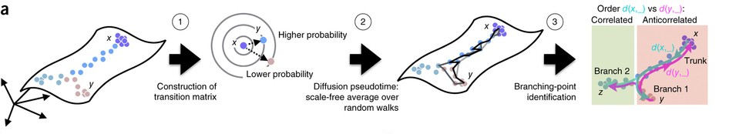
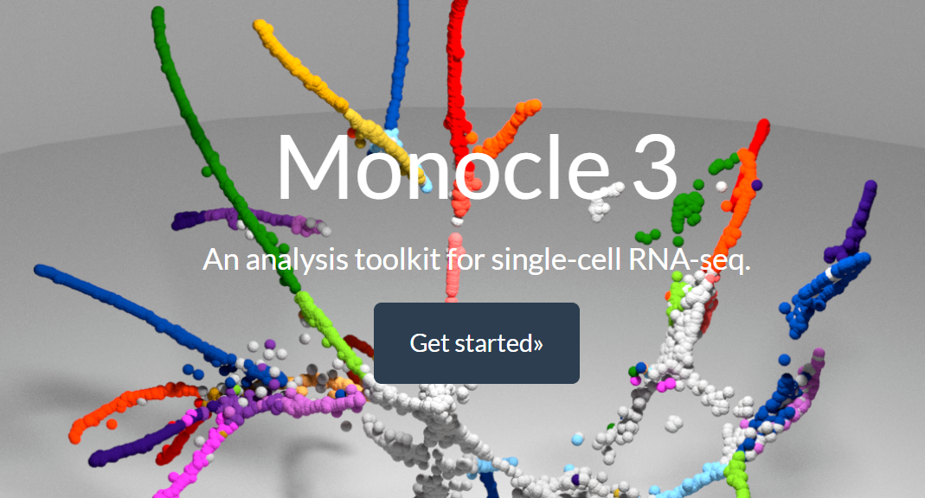
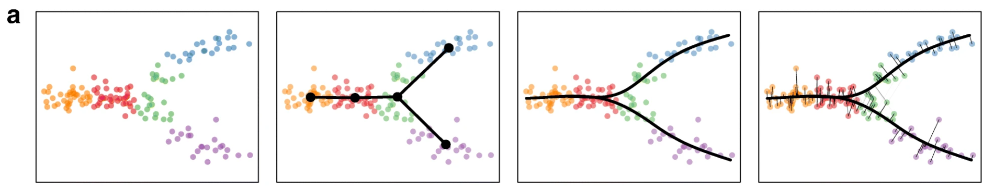
Trajectories inference methods
Q. How does the cell-type change as the human cortex develop?
the measure of how much progress an individual cells has made through a process
1. Diffusion pseudo-time
L. Haghverdi et al, Nature, 2016
2. Monocle3
3. Slingshot
K. Street et al, BMC Genomics, 2018
J. Cao et al, Nature, 2019
Notes:
After that, because the samples were collected longitudinally, starting from week8 to 26, so we were curious about what is the trajectory paths of the cells, or in other words, how does the cell-type changes as the human cortex develops?
In order to find the answer to that question, we have tried three different approaches.
In all methods, we used the arbitrary term called “pseudotime”, which refers - .., so basically we tried to calculate the pseudotime of all cells, and align them into the ascecnding order the pseudotime to determine their developmental stage.

Slide 13
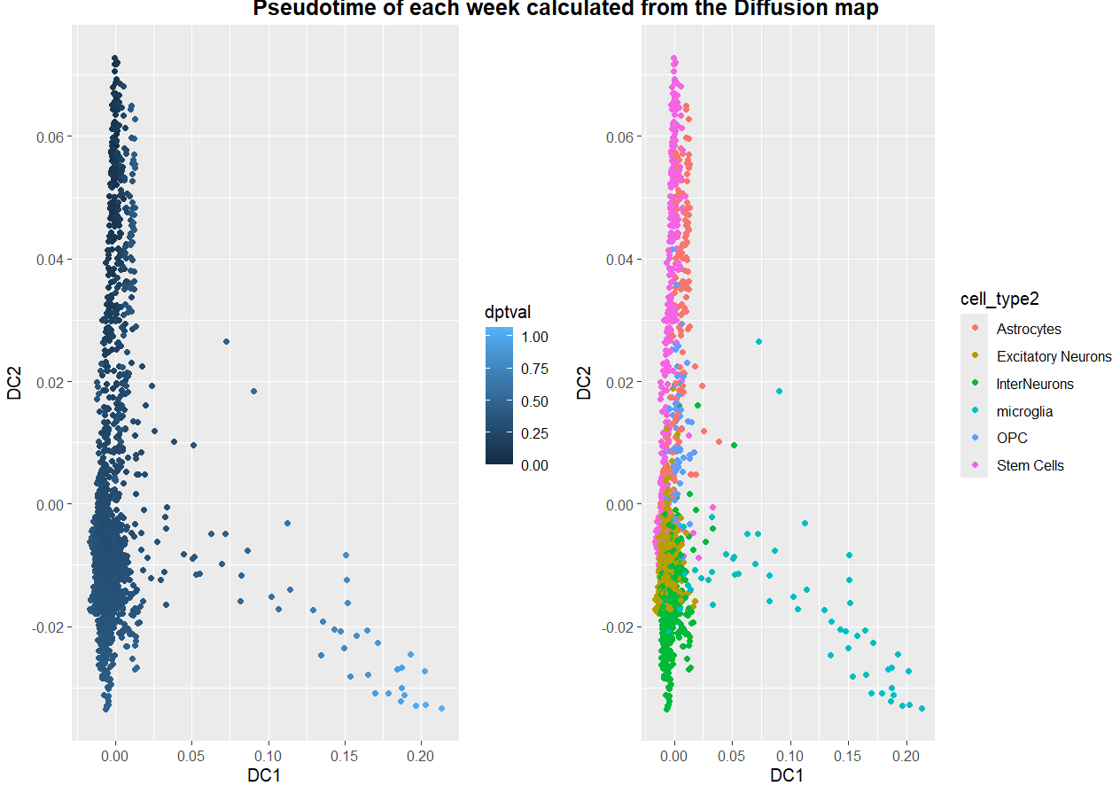
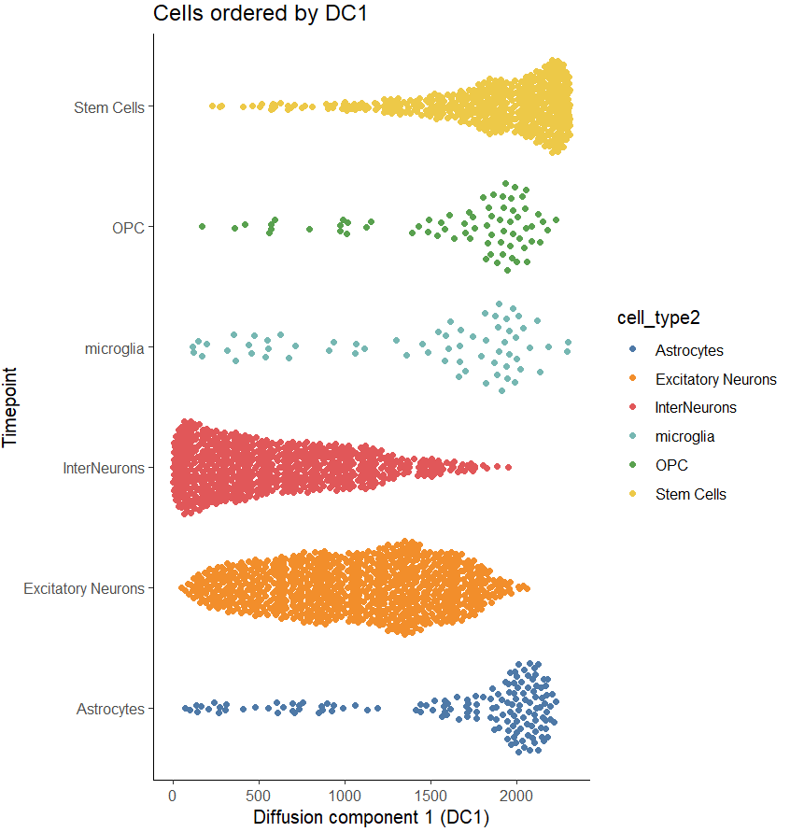

Trajectories inference using Diffusion map
Diffusion map pseudo-time performs at placing cells along the expected differentiated trajectory.
None of the PCA/UMAP/T-SNE or even diffusion map effectively segregated clusters with different cell-types.
Notes:
So, first method I applied for the trajectory inference is called the diffusion map which performs at placing cells along the expected differentiated trajectory.
This method assumes that the data points are sampled fom the diffusion process, meaning that there is a similarity between nearby data points.
After the data projection, we realized that none of the PCA/UMAP/T-SNE effectively segregated clusters based on their cell types. And as you can see in the figure here, even Diffusion map, failed to do so, as can be seen by the intermingled colors in the left side of the plot. Although it generated the calculated pseudotime for all cells, we decided to try two other pipelines and compare its result with others.
And usually in the linear algebra, eigenvectors and eigenvalues are associated with the linear transformations. And in the context of this diffusion maps, the data is transformed into a diffusion operator matrix, and it is used to estimate both eigenvalues and eigenvector which contains information about the dominant patterns or structures in the data. Using them , the high dimensional data are dimensionally reduced, therefore the data points were visualized in the diffusion map as we can see in the plot on the left.
(Cells with a lower pseudotime values are considered to be in earlier stages, while cells with higher pseudotime values are associated with later stages. Therefore we can interpret as the cells are developed from the left top to the right bottom as the time goes by. )
https://broadinstitute.github.io/2020_scWorkshop/trajectory-analysis.html#find-temporally-expressed-genes

Slide 14
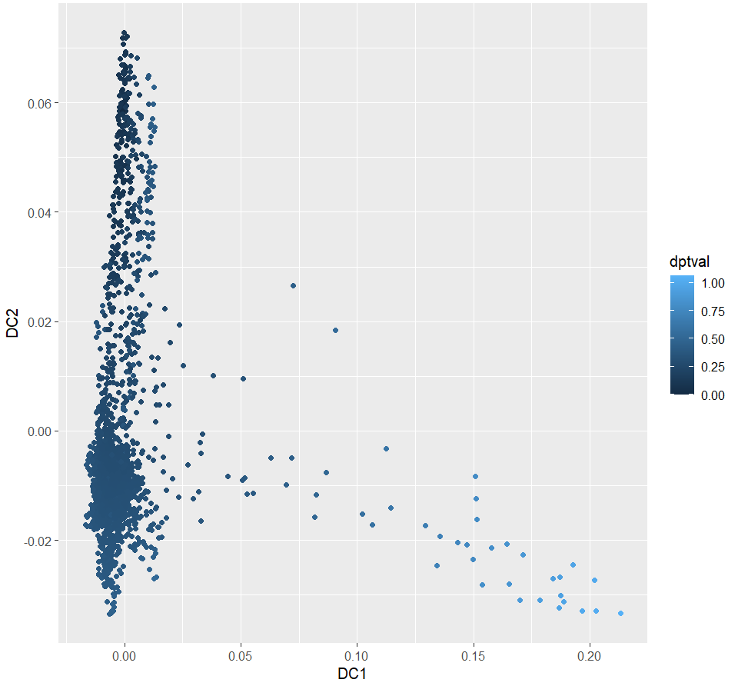


Slide 15
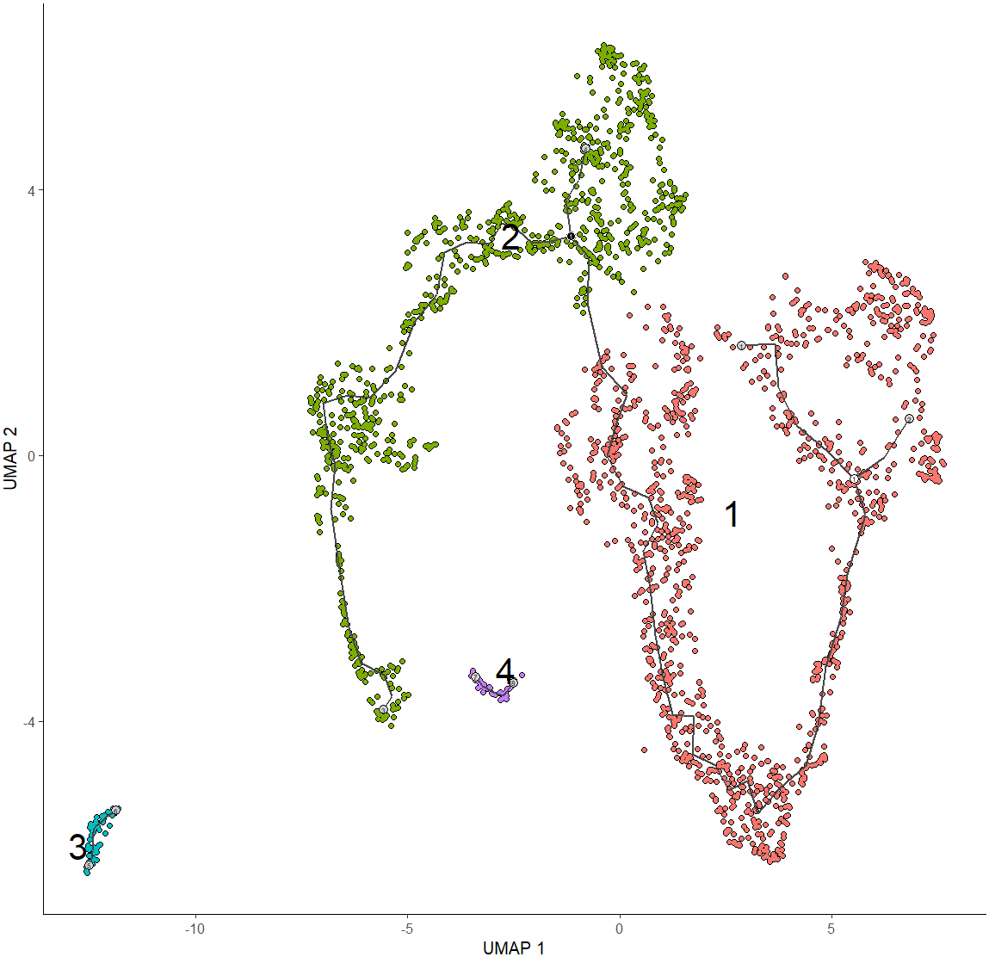
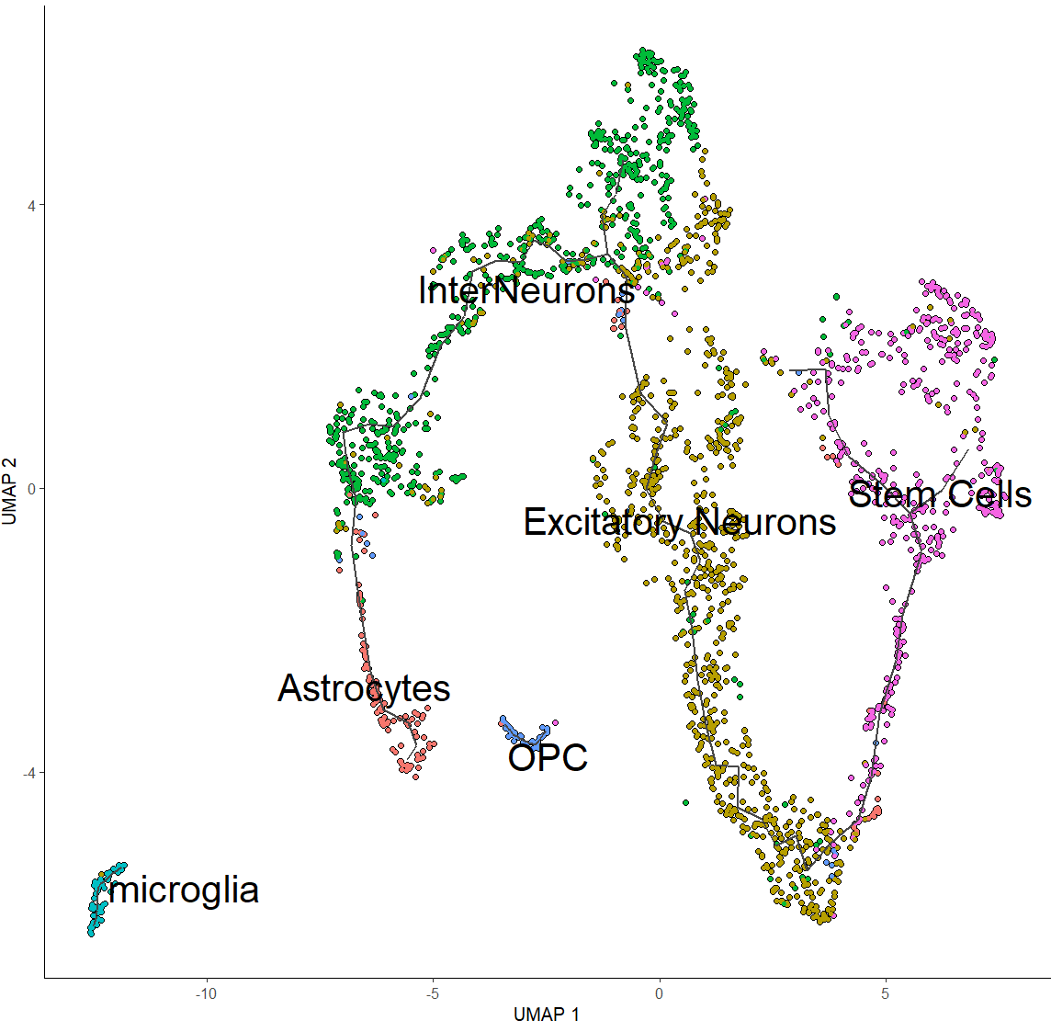
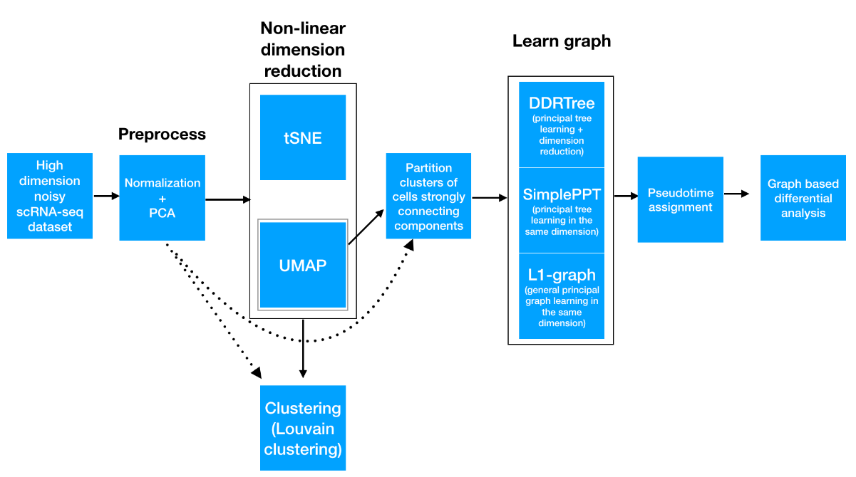
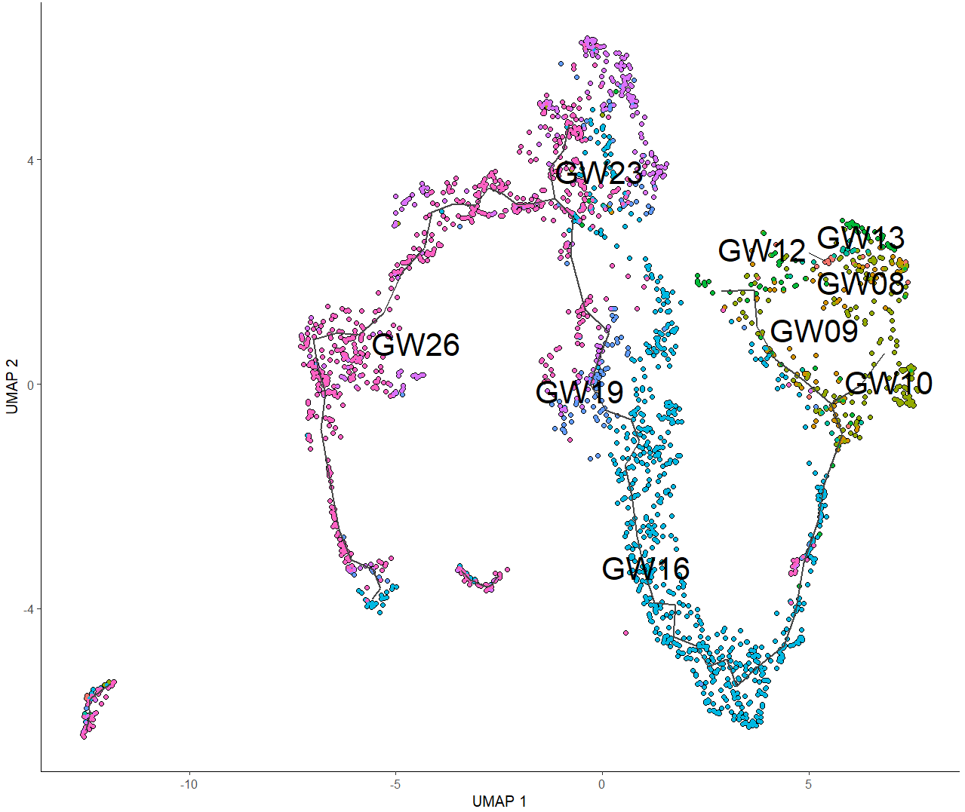
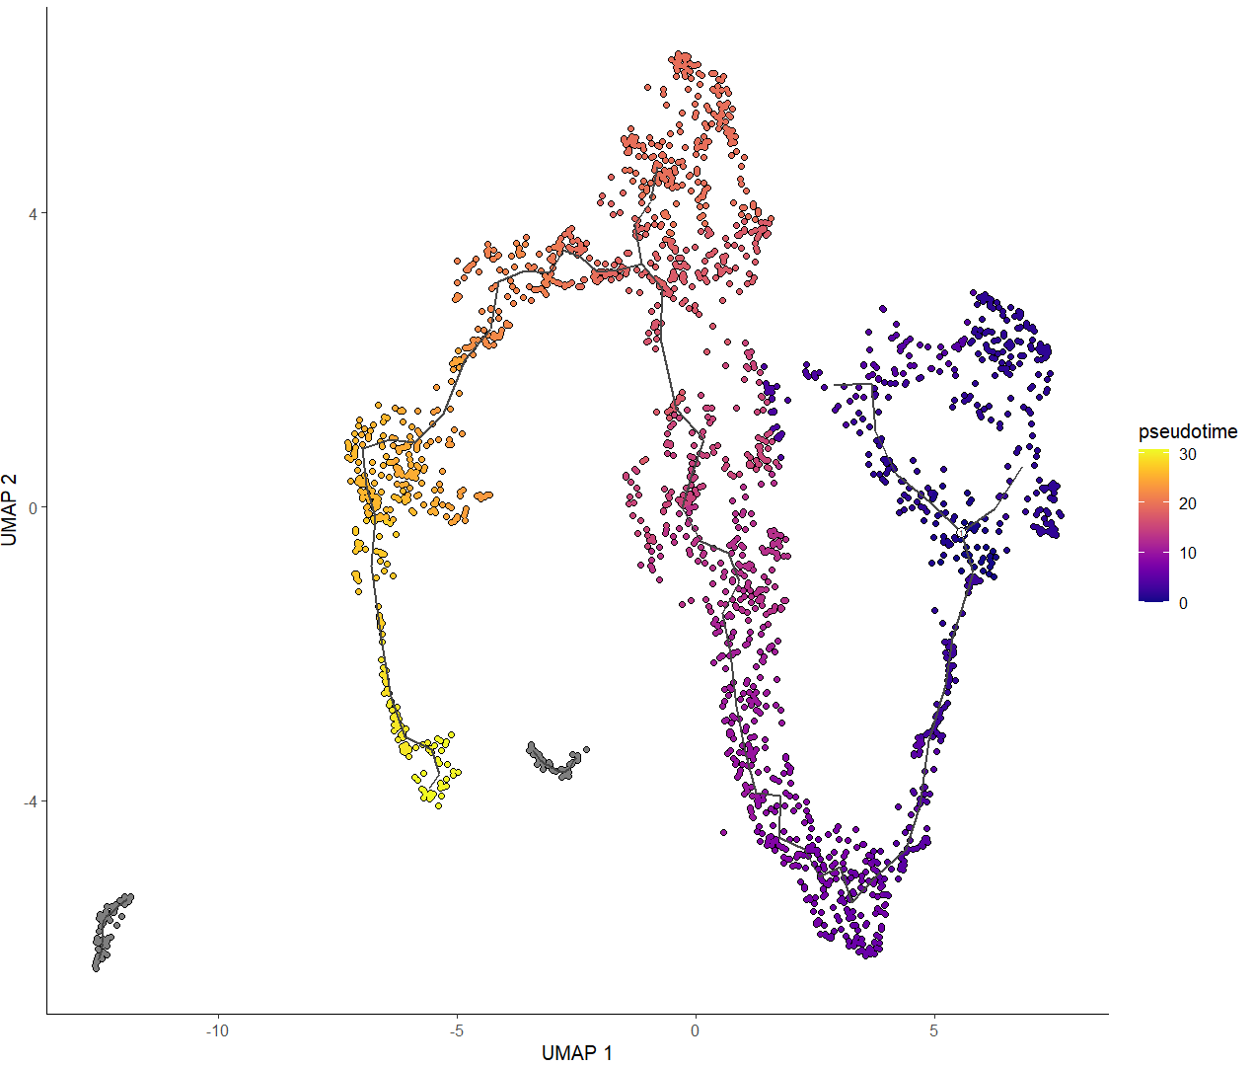
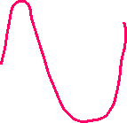
Trajectories inference using Monocle3
After the non-linear dimensional reduction step, the Monocle3 provides three different ways to organize cells into trajectories, all of which are based on the concept of “principal graph embedding”.
Notes:
The second method we tried is called monocle3, and similar to the diffusion map method, this pipeline also involves two main steps which are non-linear dimension reduction, followed by the graph construction by using the pseudotime. This monocle3 uses its principle graph embedding algorithm to construct a trajectory that represent the progression of cells along a developmental period. And as a result, there were a major cluster showing a trajectory consistent with the developmental period as GW8 – 26, along the red line. We can see that the cells starts its development process from the stem cell to excitatory neurons. … to astrocytes.
---
Normalization
Each cell is projected onto the top50 principle components
Dimensional reduction (t-SNE: this is more popular and widely accepted technique for visualizing scRNA-seq data / UMAP: faster, often better preserves the global structure of data, but is also newer and therefore less well tested by the single-cell community)
Monocle3 can learn multiple disconnected or “disjoint” trajectories. This is important because many experiments will capture a community of cells that are responding to a stimulus or undergoing differentiation, with each type of cell responding differently. The Monocle2 would incorrectly force them all into a single trajectory, Monocle3 can detect some cells are part of the different process than others in the dataset. The Monocle3 achieves this by “partitioning” the cells into “supergroups” using a method derived from “approximate graph abstraction”.

Slide 16
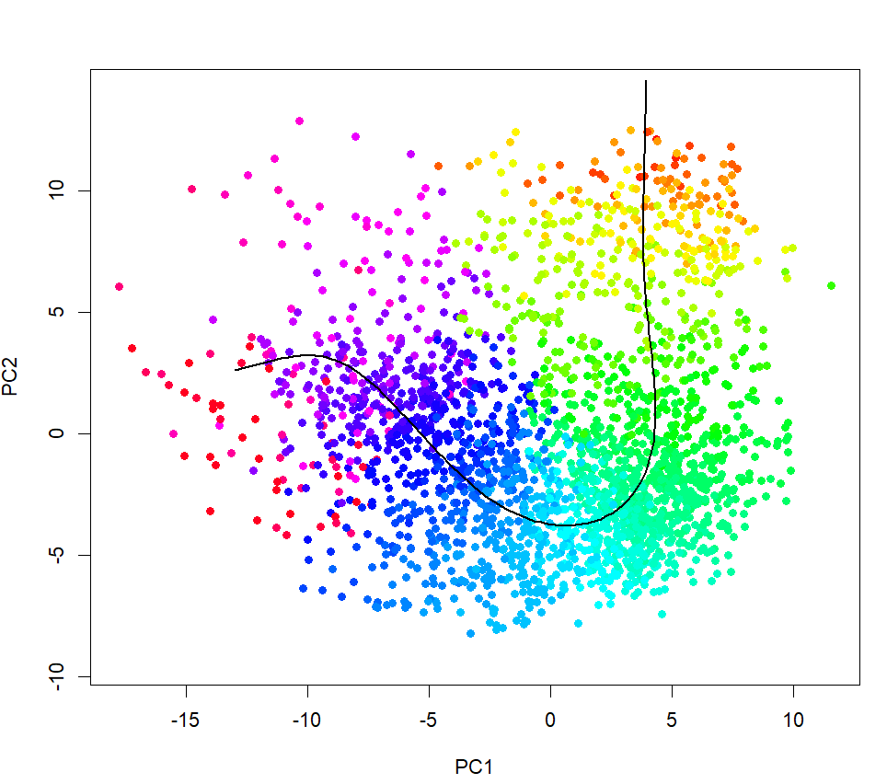
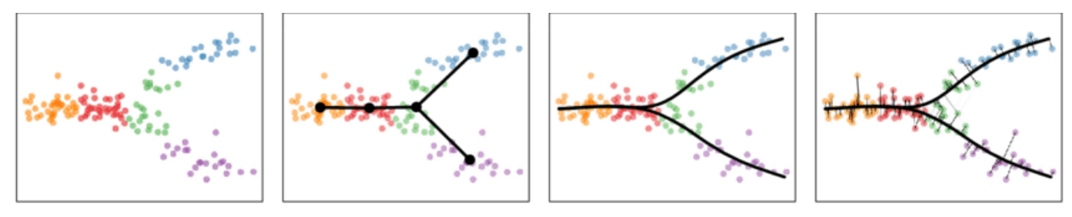
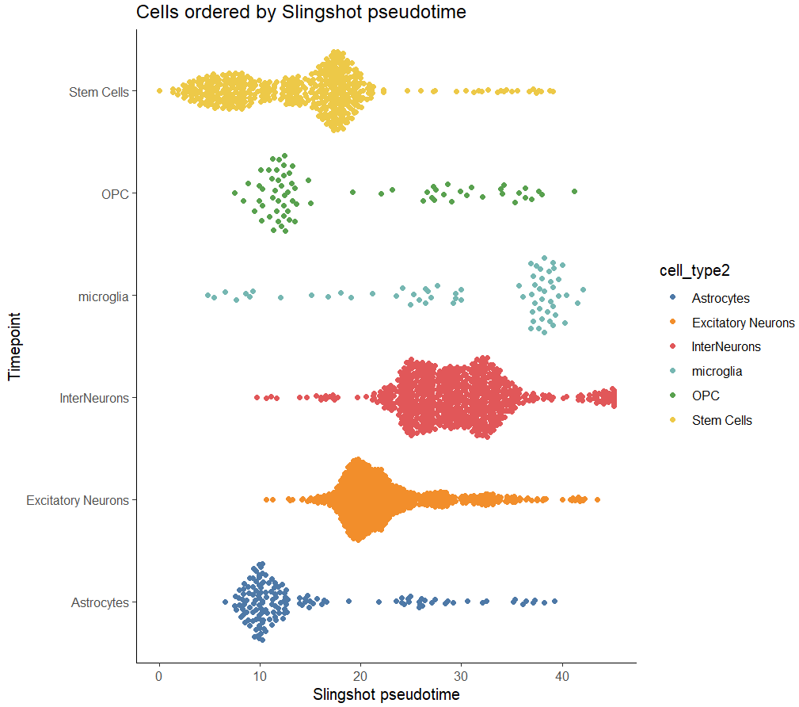

Trajectories inference using Slingshot
The goal of slingshot is to use clusters of cells to uncover global structure and convert it into smooth lineages represented by one-dimensional variables, called “pseudo-time”.
Step1) minimum spanning tree is constructed on the clusters
Step2) obtain the smooth representations of each lineage
Step3) pseudo-time values are calculated by orthogonal projection onto the curves
Some of the cell-types, such as “Stem cells”, “OPC”, “microglia”, and “Astrocytes” were not effectively clustered, resulting in sparse clustering results.
K. Street et al, BMC Genomics, 2018
Notes:
And we also tried another method is called slingshot, and “The goal of slingshot is to use clusters of cells to uncover global structure and convert it into smooth lineages represented by one-dimensional variables, called “pseudo-time”. In doing so, this method identifies the global lineage structure by constructing an minimum spanning tree (MST) on the clusters, and then construct the smooth lineages and infer pseudotime. And if we evaluate the results, We can see from the resulting figure that the some cell-types were clustered well, some of the cell types were not effectively clustered, but the trajectory line looked similar to the ones from monocle3.
i) Minimum spanning tree is constructed on the clusters to determine the number and rough shape of lineages
ii) A novel method called “Simultaneous principal curves” are used to obtain smooth representations of each lineage
iii) Pseudotime values are obtained by orthogonal projection onto the curves.
---

Slide 17
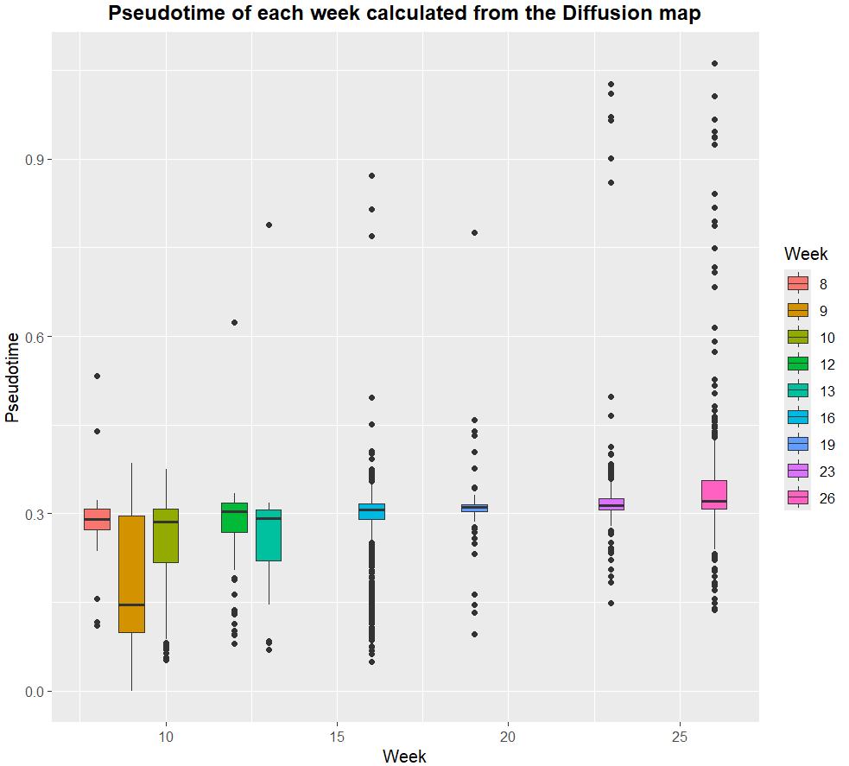
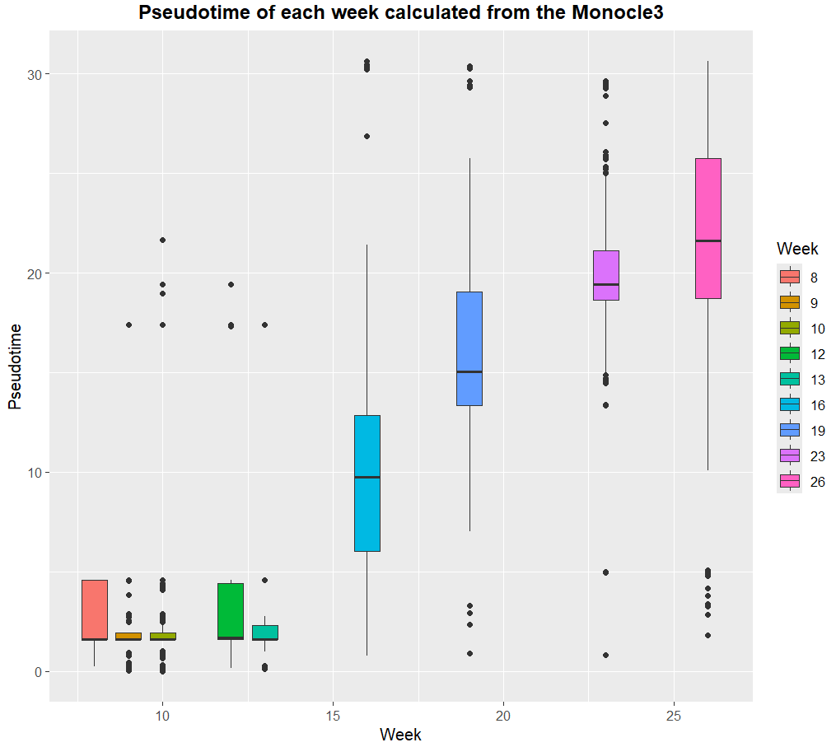
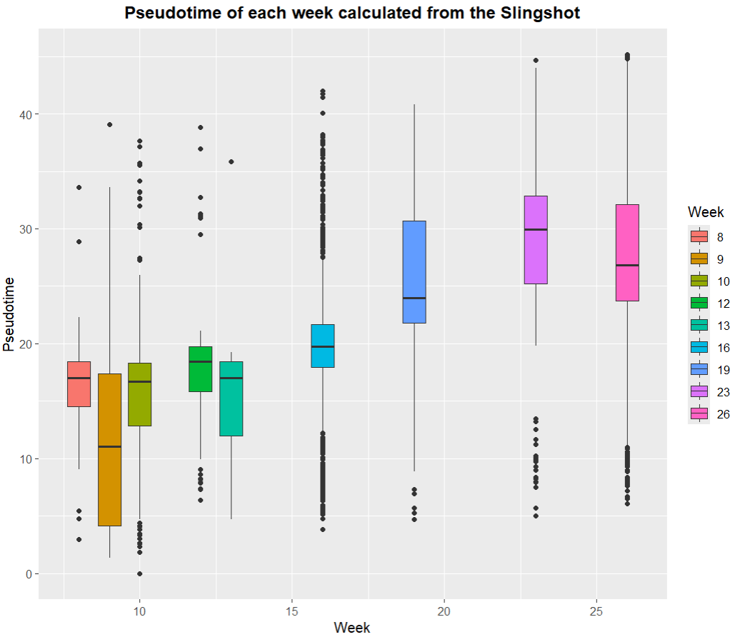
Comparison of the Trajectory analysis results
R = 0.447
P-value < 2.2e-16
R = 0.543
P-value < 2.2e-16
R = 0.803
P-value < 2.2e-16
The spearman rank-order correlation of pseudo-time and week number have been calculated.
Notes:
And as a last step of the trajectory analysis, we tried to compare the results from the three different trajectory analysis method, so we calculated the spearman correlation coefficient and its associated p-value between number of gestational week and the pseudotime calculated from the each method, and we realized that the results from the monocle3 gave the best results, although all results were significantly meaningful, as noted with the p<0.05

Slide 18
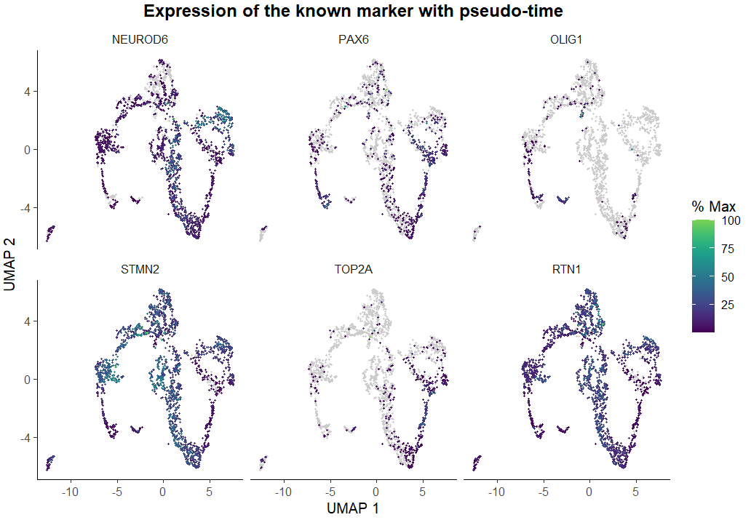
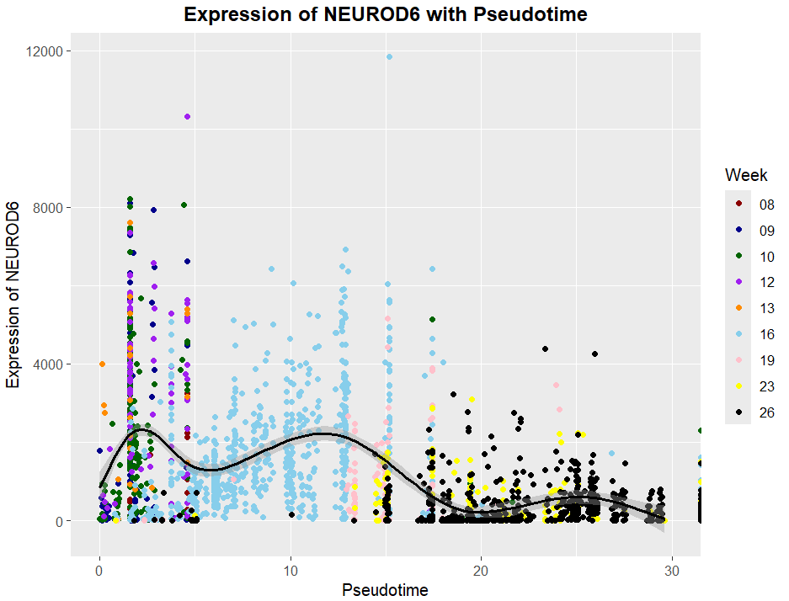
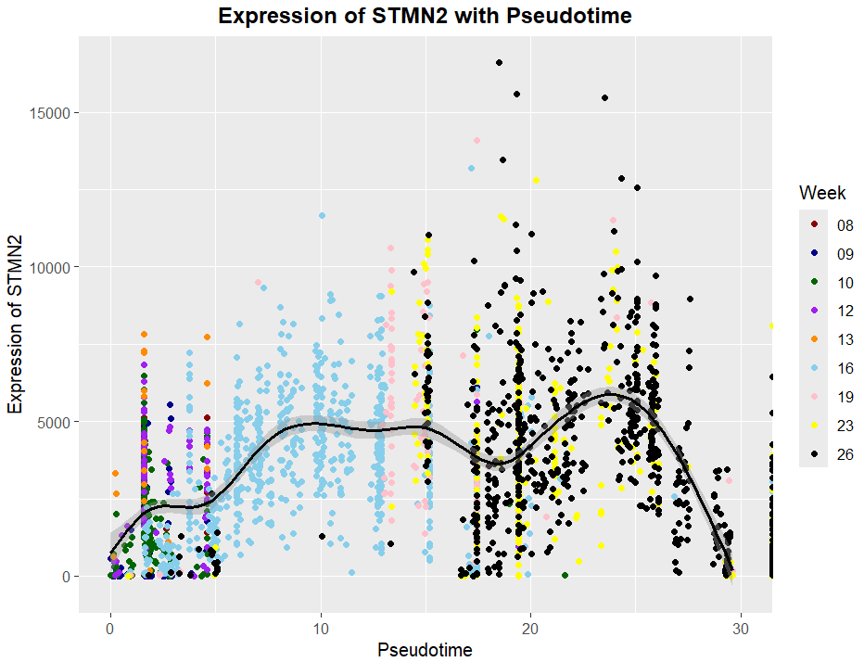


Identifying the differentially expressed genes
We have identified the differentially expressed genes with respect to pseudo-time, including the temporally expressed genes whose expression is changing in a continuous manner over pseudo-time.
NEUROD6: neurodevelopment and neuronal differentiation.
STMN2: microtubule-destabilizing protein that plays a crucial role in regulating microtubules dynamics within neurons.
Notes:
And as a last step, we wanted to know which genes’ expressions are significantly changing in a continuous manner over pseudo-time. In here, we have used the pseudotime value from the monocle3, because it gave the best result out of three methods as shown in the previous slide. The featureplot here shows the several top genes that were differentially expressed in each developmental stage, and for instance, this NEUROD6 was specifically enriched in the earlier stage of the cortex development (as the region with its high expression is same as the region where the red arrow begins), and its expression gets lower as the cortex develops (and its expression actually goes down after around 12 weeks), and this is likely be the evidence that the cell state has been determined, and move on from the Stem cell to excitatory neuron.
In conclusion,

Slide 19
Conclusion
The T-SNE and UMAP are the most suitable methods for human Prefrontal Cortex data projection.
The trajectory analysis has been performed using three different methods, diffusion map, Monocle3 and Slingshot.
Several differentially expressed genes with respect to pseudo-time have been identified, which potentially play a key role in the human Prefrontal cortex development.
Notes:
----
Three of them have different underlying principles and purposes
Diffusion map: aims to capture the global structure and relationships between cells based on their gene expression profiles. It constructs a diffusion kernel matrix that represents the diffusion process between cells and performs eigen-value decomposision to obtain diffusion components. These are then used to plot cells in low-dimensional space, giving potential cell trajectories and clusters.
Monocle3: it applies reverse graph embedding algorithm to construct a trajectory that represents the progression of cells along the developmental process.
Slingshot: it is specifically designed for capturing branching trajectories, where cells diverge into multiple lineages during development. It uses principle graph analysis to identify branch points and construct tree-like trajectory, and it’s particularly useful for studying complex developmental processes with multiple alternative fates.

